Slide 1
Blacktown Chinese Christian Church
Welcome to Our English Service 27.10.2024
English Service 9:45 – 11:00 am
Worship Songs: Passage: Speaker: Topic: Response Song: Announcements and Closing Prayer Benediction
In Christ Alone Before The Throne Of God Above Lord Of Lords Acts 16:1-15 TBA TBA TBA

Slide 2
BCCC english service

Slide 3

Please keep all phones on silent

Slide 4
In Christ Alone
Keith Getty, Stuart Townend ©2001 Thankyou Music (Admin. by SHOUT! Music Publishing Australia) CCLI Licence No. 5485849. CCLI Song number: 3350395

Slide 5
Verse 1
In Christ alone my hope is found
He is my light, my strength, my song
This Cornerstone, this solid Ground
Firm through the fiercest drought and storm

Slide 6
Verse 1
What heights of love, what depths of peace
When fears are stilled, when strivings cease
My comforter, my All in All
Here in the love of Christ I stand

Slide 7
Verse 2
There in the ground His body lay
Light of the world by darkness slain
Then bursting forth in glorious day
Up from the grave He rose again

Slide 8
Verse 2
And as He stands in victory
Sin’s curse has lost its grip on me
For I am His and He is mine
Bought with the precious blood of Christ

Slide 9
Verse 3
No guilt in life, no fear in death
This is the power of Christ in me
From life’s first cry to final breath
Jesus commands my destiny

Slide 10
Verse 3
No power of hell, no scheme of man
Can ever pluck me from His hand
Til He returns or calls me home
Here in the power of Christ I’ll stand

Slide 11
Outro
Till He returns or calls me home
Here in the power of Christ I’ll stand
Here in the power of Christ we stand

Slide 12
Before The Throne Of God Above
Charitie Lees Bancroft, Vikki Cook ©1997 Sovereign Grace Worship (Admin. by Integrity Music) CCLI Licence No. 5485849 . CCLI Song number: 2306412

Slide 13
Verse 1
Before the throne of God above
I have a strong and perfect plea
A great high priest whose name is Love
Who ever lives and pleads for me

Slide 14
Chorus
My name is graven on His hands
My name is written on His heart
I know that while in Heaven He stands
No tongue can bid me thence depart (x3)

Slide 15
Verse 2
When Satan tempts me to despair
And tells me of the guilt within
Upward I look and see Him there
Who made an end of all my sin

Slide 16
Chorus
Because a sinless Savior died
My sinful soul is counted free
For God the just is satisfied
To look on Him and pardon me (x3)

Slide 17
Verse 4
Behold Him the risen Lamb
My perfect spotless righteousness
The great unchangeable I am
The King of glory and of grace

Slide 18
Chorus
One in Himself, I cannot die
My soul is purchased by His blood
My life is hid with Christ on high
With Christ, my Savior and my God (x3)

Slide 19
Lord Of Lords
CCLI Licence No: 5485849

Slide 20
Verse 1
Beholding Your beauty
Is all that I long for
To worship You Jesus
Is my sole desire

Slide 21
Verse 1
For this very heart
You have shaped for Your pleasure
Purposed to lift Your Name high

Slide 22
Verse 2
Here in surrender
In pure adoration
I enter Your courts
With an offering of praise

Slide 23
Verse 2
I am Your servant
Come to bring You glory
As is fit for the work of Your hands

Slide 24
Chorus
Now unto the Lamb
Who sits on the throne
Be glory and honour and praise
All of creation resounds with the song

Slide 25
Chorus
Worship and praise Him
The Lord of lords

Slide 26
Verse 3
Spirit now living
And dwelling within me
Keep my eyes fixed
Ever on Jesus' face

Slide 27
Verse 3
Let not the things of this world
Ever sway me
I'll run 'til I finish the race

Slide 28
Chorus
Now unto the Lamb
Who sits on the throne
Be glory and honour and praise
All of eternity echoes the song

Slide 29
Chorus
Worship and praise Him
The Lord of lords

Slide 30
Bridge
Holy Lord
You are holy
Jesus Christ
Is the Lord (x3)

Slide 31
Chorus
Now unto the Lamb
Who sits on the throne
Be glory and honour and praise
Call all the saints to join in the song

Slide 32
Chorus
Worship and praise Him
The Lord of lords

Slide 33
Outro
Lord of lords
Lord of lords
Lord of lords

Slide 34

Bible reading

Slide 35
Bible reading: Acts 16:1-15
Paul came to Derbe and then to Lystra, where a disciple named Timothy lived, whose mother was Jewish and a believer but whose father was a Greek. ² The believers at Lystra and Iconium spoke well of him.

Slide 36
Bible reading: Acts 16:1-15
³ Paul wanted to take him along on the journey, so he circumcised him because of the Jews who lived in that area, for they all knew that his father was a Greek. ⁴ As they traveled from town to town, they delivered the decisions reached by the apostles and elders in Jerusalem for the people to obey.

Slide 37
Bible reading: Acts 16:1-15
⁵ So the churches were strengthened in the faith and grew daily in numbers.
⁶ Paul and his companions traveled throughout the region of Phrygia and Galatia, having been kept by the Holy Spirit from preaching the word in the province of Asia.

Slide 38
Bible reading: Acts 16:1-15
⁷ When they came to the border of Mysia, they tried to enter Bithynia, but the Spirit of Jesus would not allow them to. ⁸ So they passed by Mysia and went down to Troas.

Slide 39
Bible reading: Acts 16:1-15
⁹ During the night Paul had a vision of a man of Macedonia standing and begging him, “Come over to Macedonia and help us.” ¹⁰ After Paul had seen the vision, we got ready at once to leave for Macedonia, concluding that God had called us to preach the gospel to them.

Slide 40
Bible reading: Acts 16:1-15
¹¹ From Troas we put out to sea and sailed straight for Samothrace, and the next day we went on to Neapolis. ¹² From there we traveled to Philippi, a Roman colony and the leading city of that district of Macedonia. And we stayed there several days.

Slide 41
Bible reading: Acts 16:1-15
¹³ On the Sabbath we went outside the city gate to the river, where we expected to find a place of prayer. We sat down and began to speak to the women who had gathered there. ¹⁴ One of those listening was a woman from the city of Thyatira named Lydia, a dealer in purple cloth. She was a worshiper of God. The Lord opened her heart to respond to Paul’s message.

Slide 42
Bible reading: Acts 16:1-15
¹⁵ When she and the members of her household were baptized, she invited us to her home. “If you consider me a believer in the Lord,” she said, “come and stay at my house.” And she persuaded us.

Slide 43
Announcements

Slide 44





Account name: Blacktown Chinese Christian Church
Account number: 4216 50263
Offering
BSB: 112 - 879
Please put in "offering" as the reference
The offering box is available at the back of the hall

Slide 45
Prayer points

Slide 46
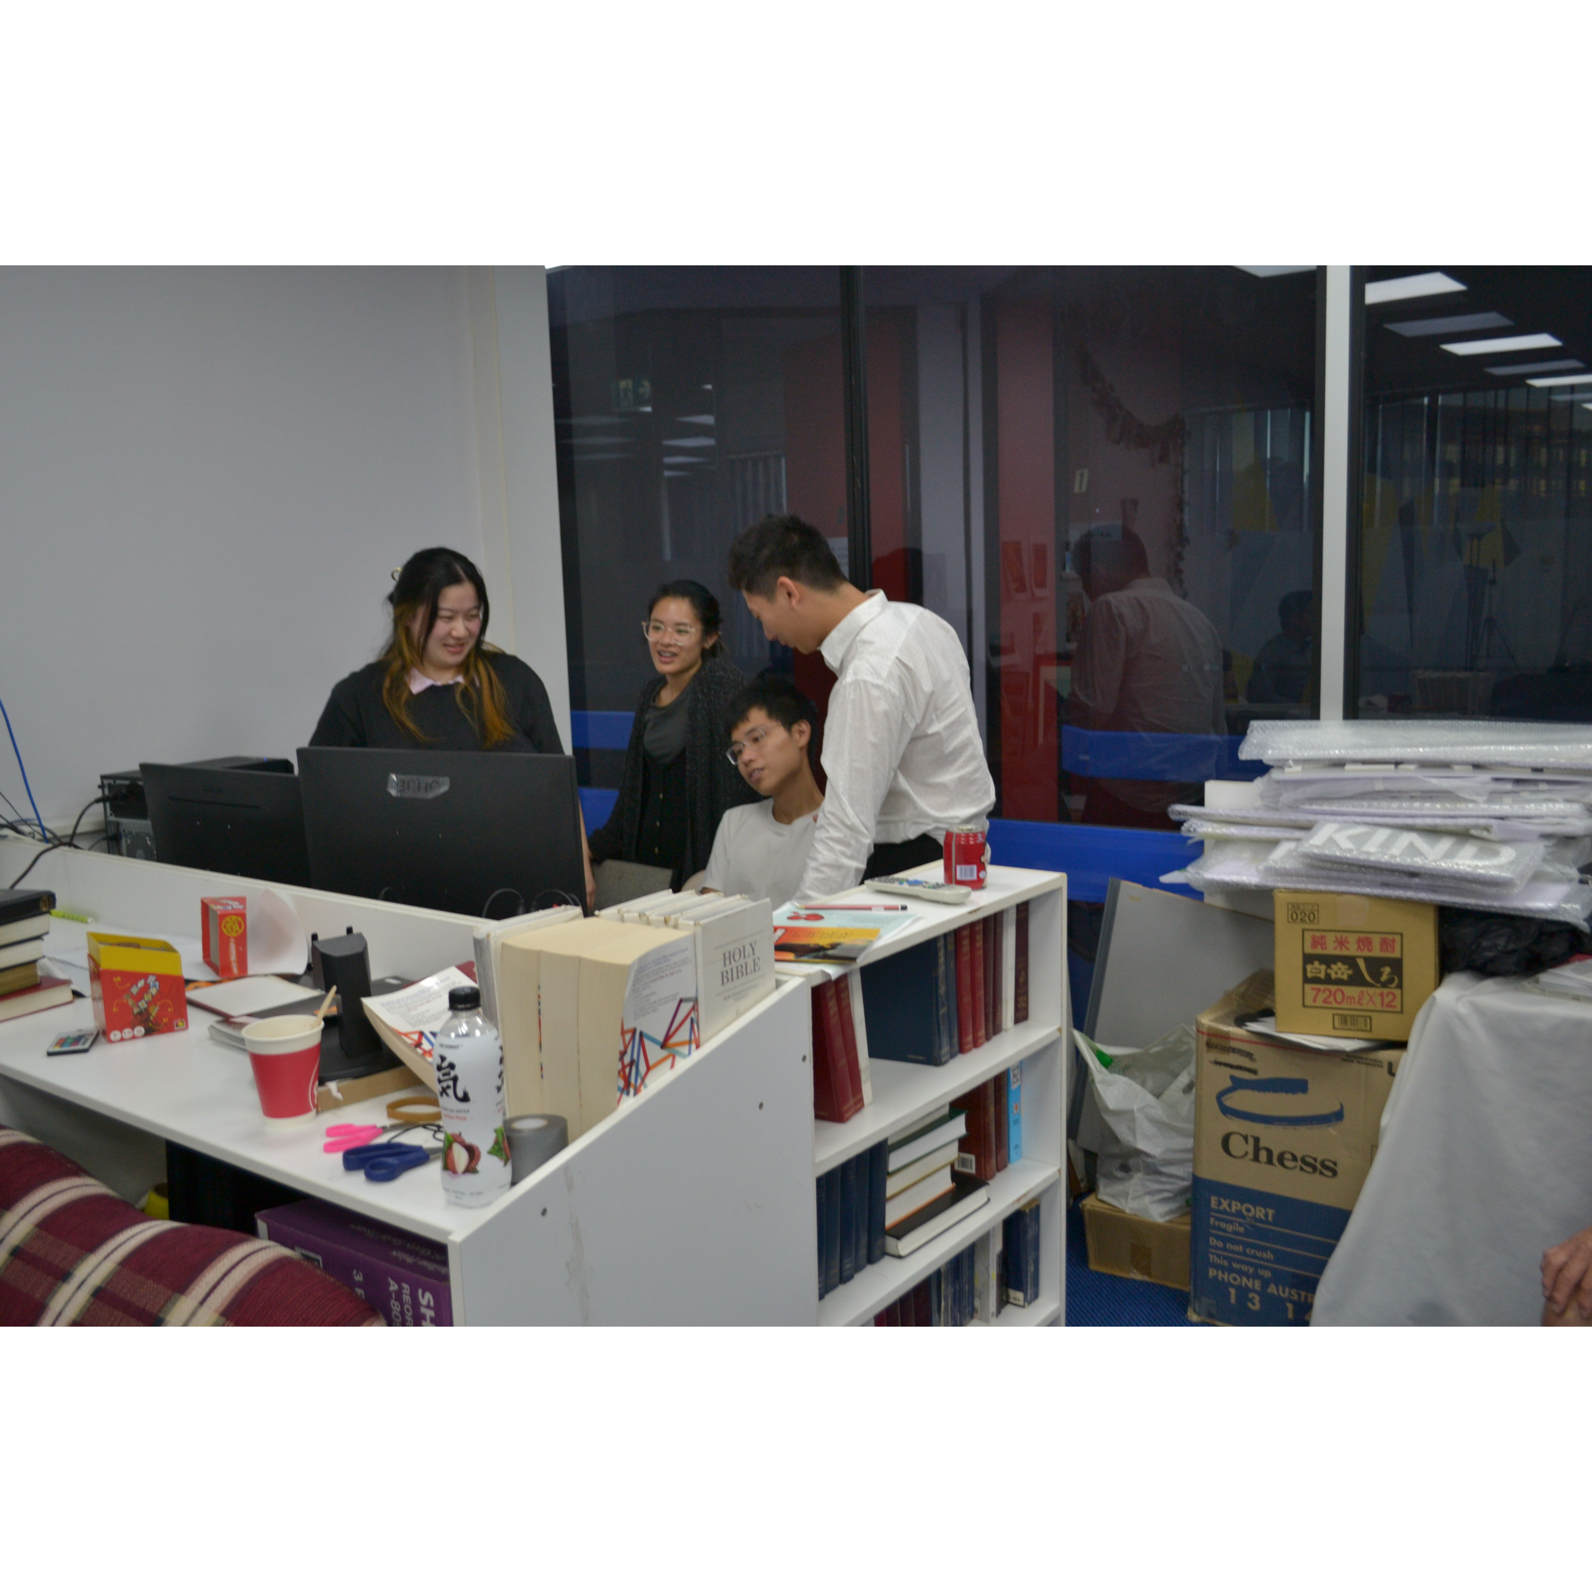
Mingle time!

